Slide 1

In Lección 7 of Descubre, nivel 1 you learned how to use se as the third-person reflexive pronoun (El se despierta. Ellos se visten. Ella se baña.).
Se can also be used to form constructions in which the person performing the action is not expressed or is de-emphasized.
© by Vista Higher Learning, Inc. All rights reserved.
1.3-<number>

Slide 2
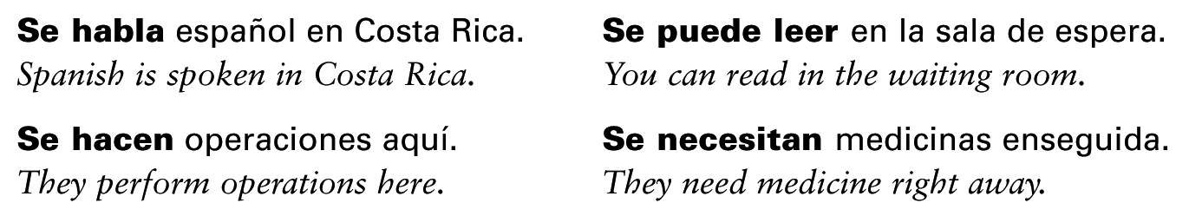
Se + verb
In Spanish, verbs that are not reflexive can be used with se to form statements in which the person performing the action is not defined.
© by Vista Higher Learning, Inc. All rights reserved.
1.3-<number>

Slide 3
¡Atención! Note that the third person singular verb form is used with singular nouns and the third person plural form is used with plural nouns.
© by Vista Higher Learning, Inc. All rights reserved.
1.3-<number>

Slide 4

You often see se in signs, advertisements, and directions.
© by Vista Higher Learning, Inc. All rights reserved.
1.3-<number>

Slide 5
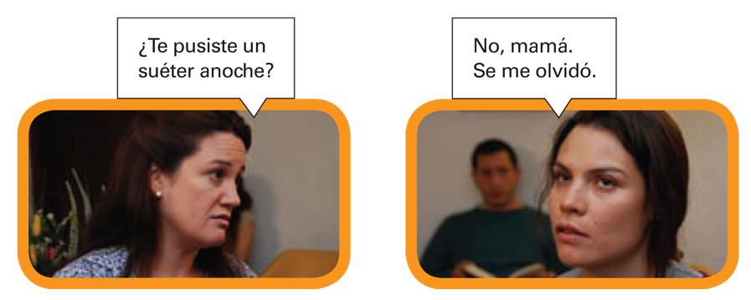
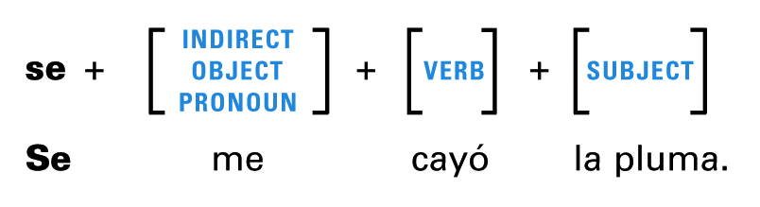
Se for unplanned events
Se also describes accidental or unplanned events. In this construction, the person who performs the action is de-emphasized, implying that the accident or unplanned event is not his or her direct responsibility. Note this construction.
© by Vista Higher Learning, Inc. All rights reserved.
1.3-<number>

Slide 6
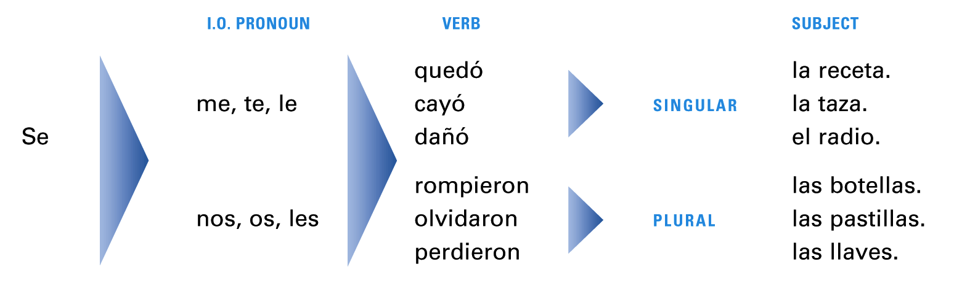
In this type of construction, what would normally be the direct object of the sentence becomes the subject, and it agrees with the verb, not with the indirect object pronoun.
© by Vista Higher Learning, Inc. All rights reserved.
1.3-<number>

Slide 7
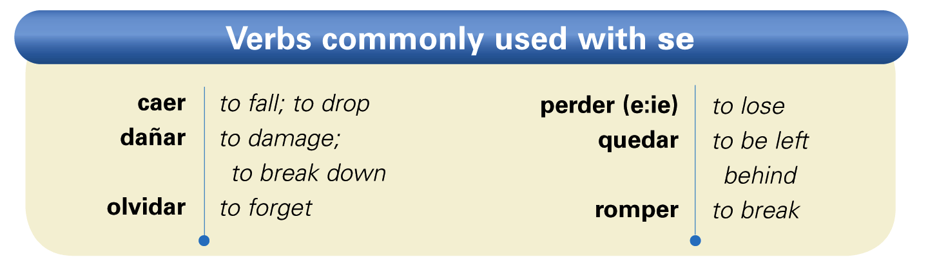
These verbs are the ones most frequently used with se to describe unplanned events.
© by Vista Higher Learning, Inc. All rights reserved.
1.3-<number>

Slide 8
¡Atención! While Spanish has a verb for
to fall (caer), there is no direct translation for to drop. Dejar caer (To let fall) or a se construction is often used to mean to drop.
© by Vista Higher Learning, Inc. All rights reserved.
1.3-<number>

Slide 9
To clarify or emphasize who the person involved in the action is, this construction commonly begins with the preposition
a + [noun] or a + [prepositional pronoun].
© by Vista Higher Learning, Inc. All rights reserved.
1.3-<number>

Slide 10

Completa las oraciones con se + la forma correcta del verbo.
___________ (enseñar) cinco lenguas en esta escuela. __________ (comer) muy bien en Las Delicias. __________ (vender) muchas camisetas allí. __________ (servir) platos exquisitos cada noche. Completa las oraciones con se y los verbos en pretérito. _________________ (I broke) las gafas. __________ (You [fam., sing.]) dropped) las pastillas. __________ (They lost) la receta. __________ (You [form., sing.] left) aquí la radiografía.
A
Se enseñan
B
Se me rompieron
© by Vista Higher Learning, Inc. All rights reserved.
1.3-<number>

